Slide 1
Capstone Project: Car Accident Severity
Coursera – Applied Data Science Capstone - IBM

Slide 2
Introduction
Car collision is one of the leading causes of premature death in countries all around the globe. Different factors, many preventable, play parts in how severe car accidents are. This project will explore which factors are most associated with fatal collisions, and with that, provide recommendations on what can be done from a city design and policy perspective to minimize the severity of car collisions.

Slide 3
Data
Data on measurable factors related to car accidents, along with the severity of said accidents, are required to assess what affects the severity of car accidents. It would also be beneficial for data on accidents to cover a variety of different scenarios and locations as this would allow many different factors to be under assessment. With these requirements, the Seattle Traffic Records is to be used as it satisfies the previously mentioned conditions and provides a large dataset for analyses to be conducted.

Slide 4
Methodologies
An exploration of the available columns was first conducted to assess which features would be required for the analysis. Given that the issue under investigation for the project was the impact that city design and public policy has on the severity of car collisions, the following features had been analyse and investigated during this project:
Address Type
Lighting Condition
Junction Type
Weather Condition
Under the Influenced (Y/N)
Speeding (Y/N)

Slide 5
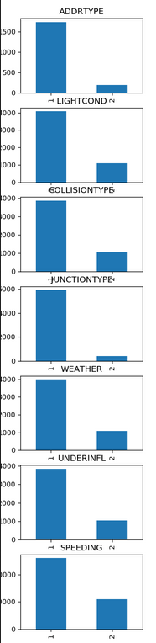
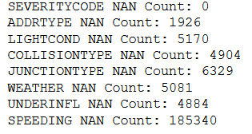
Methodologies
As many of these features contain null values, an analysis these values for the features was conducted. For features that contain values such as “Unknown” or “No,” null values for those fields are replaced with such values.
As for the remaining features, as One-Hot Encoding were to be used in the pipeline. The features were left as is.

Slide 6
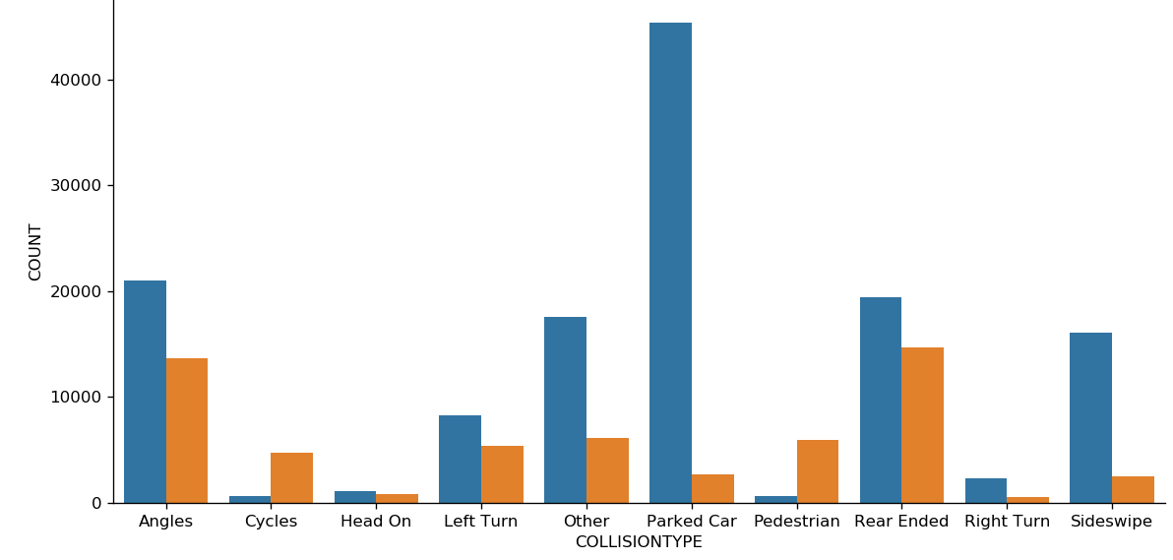
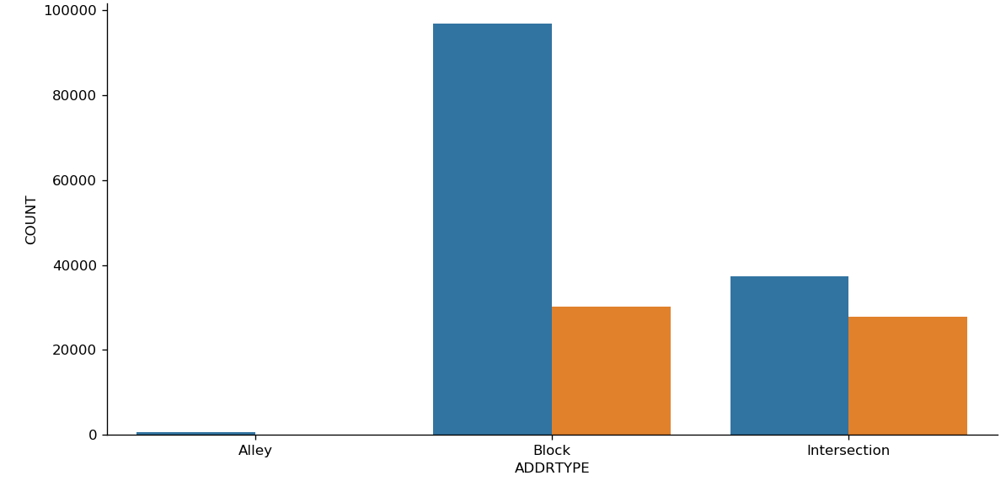
Methodologies
A preliminary look at the feature set in regards to the target reveals that some of these features do have a very significant impact on the target feature. When looking at this chart, for example, it is clear that “Rear Ended” collisions are more likely to be more serious than “Sideswipe” collisions.

Slide 7
Methodologies
To confirm these interactions, machine learning models were trained using the data set (3:1 data split). Due to the nature of the dataset, decision tree classifiers and random forest classifiers where used as algorithms for the models.

Slide 8
Results
When looking at the model that specifically looks at public policy related features (i.e., whether the driver is under the influence or is speeding.) It is clear that these factors has a direct impact on the severity of car accidents. The model was able to categorize with 91% accuracy given information on whether or not the driver is under the influence or is speeding with both of these factors directly correlated with a higher chance of a more severe collision.
As for city design related features, the model was able to predict with 77% accuracy based off of these features alone with address type, lighting condition and weather having the most impact on the severity of the collision.

Slide 9
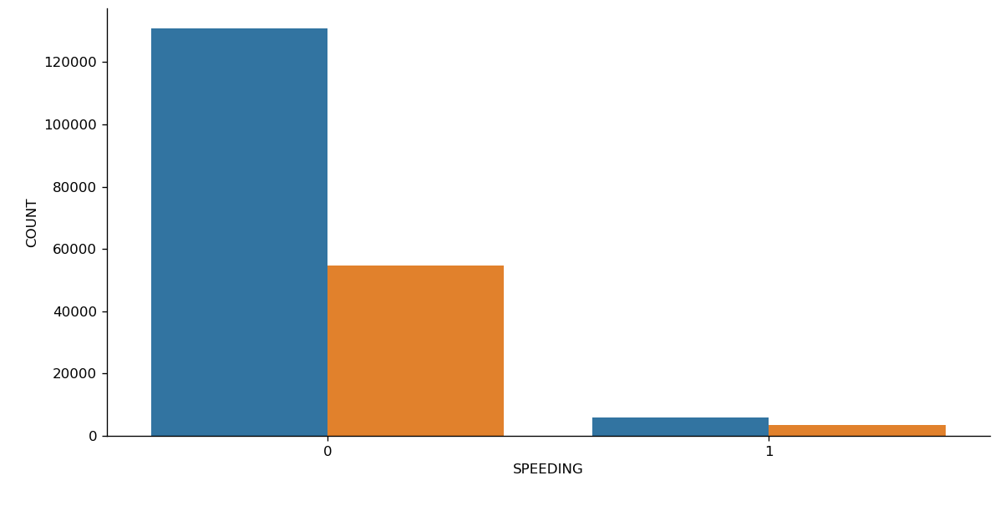
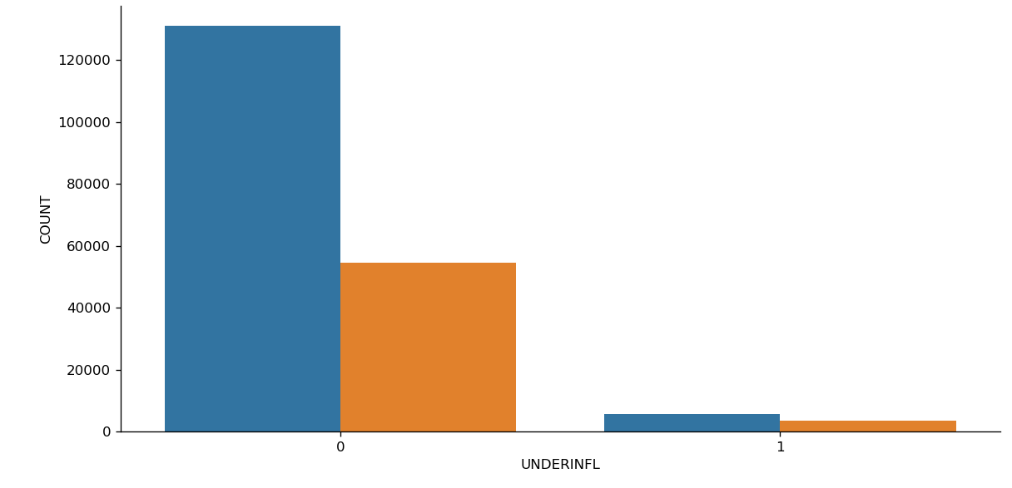
Discussions
It is clear that public policy related features has a more significant impact on the severity of car accidents than city design features. As speeding and driving under the influence are the two most impactful features, public policies that address these issues, for example more speed cameras or more severe drunk driving punishments, should be implemented.

Slide 10
Conclusion
Both public policy related features and city design related features plays a role in the severity of car accidents. As confirmed by the models, these information on these features allows us to predict, with a high degree of confidence, the severity of the associated car accident; meaning that these features has a material impact on whether or not a car accident is of high severity.

